Slide 1

Heart Disease Prediction using Logistic Regression
Machine Learning Project
Sushant Ratawa
Notes:
1

Slide 2

The Critical Need for Early Detection
Understanding Heart Disease
Our ML Solution
This project harnesses the power of machine learning to predict heart disease risk using patient health data. By analyzing key medical indicators, we can identify high-risk individuals and enable proactive intervention.
Heart disease remains the leading cause of death globally, affecting millions of people each year. It encompasses various conditions that impair the heart's ability to function properly, including coronary artery disease, heart attacks, and arrhythmias.
Logistic regression provides an interpretable, efficient approach that helps medical professionals make informed decisions quickly.
Early detection is crucial — identifying risk factors before symptoms appear can save lives and reduce healthcare costs dramatically.
Notes:
2

Slide 3




Dataset & Technology Stack
Dataset Source
Key Features
heart.csv from kaggle.com
Age & Sex
Comprehensive patient records with validated medical indicators
ChestPainType
Cholesterol levels
RestingBP
MaxHeartRate
Libraries Used
NumPy — numerical computing
Pandas — data manipulation
Scikit-learn — ML algorithms
Notes:
3

Slide 4

Why Logistic Regression?
Perfect for Binary Classification
The Sigmoid Function
Medical Decision Support
At its core, logistic regression uses the sigmoid function to transform linear predictions into probabilities. This S-shaped curve ensures outputs always fall between 0 and 1, perfect for risk assessment.
Logistic regression excels at yes/no predictions — in our case, predicting whether a patient has heart disease or not. It outputs probabilities between 0 and 1, making results easy to interpret.
Unlike complex "black box" models, logistic regression provides interpretable coefficients. Doctors can understand which factors contribute most to the prediction, building trust in the system.
Notes:
4

Slide 5





Model Development Workflow
Data Loading
Import heart.csv dataset with patient records
Preprocessing
Clean data, handle missing values, normalize features
Train/Test Split
Divide data for training and validation
Model Training
Fit logistic regression on training data
Evaluation
Assess accuracy and performance metrics
Notes:
5

Slide 6
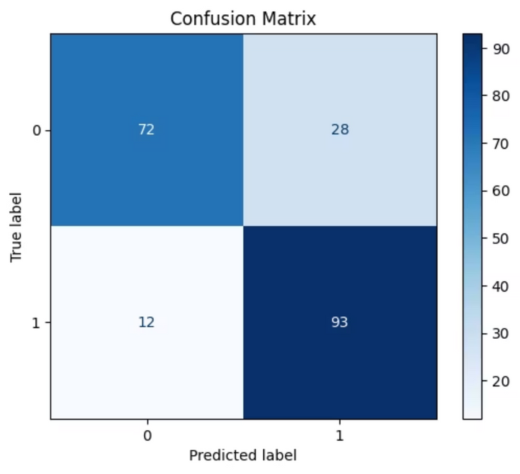
Model Performance & Results
Prediction Accuracy
Our logistic regression model successfully classified heart disease cases with high accuracy, demonstrating the effectiveness of ML in medical diagnosis.
85%
80%
Training Accuracy
Test Accuracy
Model performance on training dataset
Validation on unseen patient data
The model effectively identifies key risk factors including age, chest pain type, and cholesterol levels. Low false negatives ensure high-risk patients aren't missed.
Notes:
6

Slide 7




Conclusion & Future Directions
Key Achievement
Medical Impact
Successfully developed an accurate, interpretable model for heart disease prediction using logistic regression. The system provides reliable risk assessment that can support clinical decision-making.
Machine learning transforms healthcare by enabling early intervention and personalized treatment plans. Predictive analytics can save lives by identifying at-risk patients before symptoms appear.
Next Steps
Expand dataset with more patient records
Test advanced models (Random Forest, Neural Networks)
Develop web application for real-time predictions
Integrate with electronic health record systems
Notes:
7

